Slide 1
Extinction yr 12 atar biology
Ms Rayner 2022

Slide 2
After view the documentary…
Fill the blanks
Extinction is a natural process
Background extinction is the steady rate of turnover of species
Mass extinction normally occurs as a result of a catastrophic geologic event
Human activites contribute to extinction through the destruction of habitat and food sources, over-exploitation (hunting, food, medicine), pollution, introduced species and changed fire regimes

Slide 3
Extinction
When a large-scale extinctions occur, not all species are lost
Some seem more at risk than others
Read the 2 articles on pages 1 and 2. Using a highlighter, highlight references to:
Genetic diversity
Extinction
Population size/declines
Conservation measures

Slide 4
After reading….
Complete the sentence below by filling the blank
Populations with reduced genetic diversity are less resistant to a changing environment
What are the dangers of reduced genetic diversity?
Reduced disease resistance, potential for adaptability decreases – less able to adapt in a changing environment

Slide 5
After reading…
Why is the decline in native species population a warning sign that extinction may be around the corner?
Genetic diversity decreases in smaller populations (gene pool is less genetically diverse), this will lead to more inbreeding. Less genetically diverse gene pool increases the risk of extinction as the population will be more susceptible to disease and less able to adapt to a changing environment
Why have scientists decided to introduce a bandicoot from a healthy population in Tasmania into a declining population in Victoria?
Help increase diversity of the gene pool by increasing gene flow (the transfer of alleles that results from emigration, immigration and migration of individuals between populations)

Slide 6
After reading…
Why is it important that the bandicoots are released into a fenced habitat free of foxes and rabbits?
So will not be predated on by foxes and will have no competition from rabbits for habitat or food resources
What other considerations would need to be taken into account before releasing the bandicoots into the fenced habitat?
Food sources, habitat (appropriate for burrowing), size of the enclosure large enough
What Biotechnology tools do you think would be useful to investigate the genetic diversity of a threatened species?
DNA extraction, PCR to amplify small samples of DNA, resistriction enzymes to create STR’s, Gel electrophoresis to create a DNA profile.

Slide 7
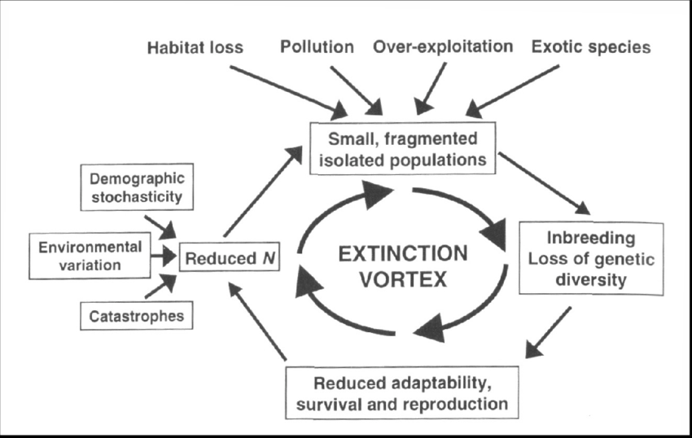
Reduced genetic diversity
Reduced genetic diversity can be caused by a bottlenecking event in the population
Effects of genetic drift (a change in the gene pool of a population as a result of chance) are largest in small populations
After a bottlenecking event the new, very much reduced population with limited genetic diversity will be the founders of a larger population
For example: rescuing critically endangered populations using very few breeding pairs. For this reason

Slide 8
Extinction

Slide 9
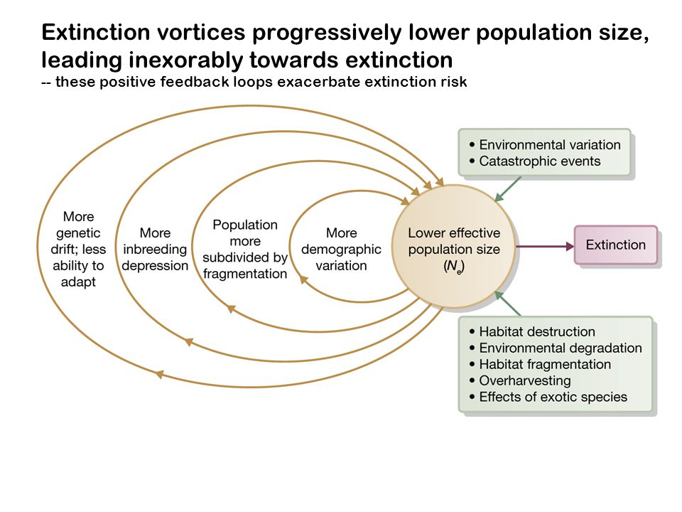
Extinction

Slide 10
Characteristics of a viable population
Range of genetic diversity/alleles (diverse gene pool)
Large enough numbers of breeding individuals to cope with random genetic drift
Appropriate number of males and females

Slide 11
Conservation planning for species at risk of extinction
Role of biogeography, reproductive behaviour and population dynamics in maintaining a viable population

Slide 12
Biogeography
Definition - presence, absence and distribution of organisms in an area
solitary or herd/group affects the size of the territory required, or reproductive success
size of the territory–minimum habitat required for general group size

Slide 13
Reproductive behaviour
includes all the events and actions that are directly involved in the process by which an organism generates at least one replacement of itself
small population size –inbreeding reduces genetic variation
breeding season optimises survival of offspring
mate selection/polygamy versus monogamy affects genetic diversity
visual, auditory and/or olfactory clues increases efficiency of two individuals finding each other
courtship reduces hostility between partners/selection of partners with advantageous characteristics
degree of parental care affects survival of offspring to maturity

Slide 14
Population dynamics
Definition–study of changes in population size, density and dispersal
availability of prey/abundance of food
abundance of predators/predator control
exposure to disease
competition with other species/occupying the same niche
variation in the physical parameters of the environment –dispersal
consideration of territories/home ranges for population size
expected population growth–carrying capacity of the area

Slide 15
Genetic strategies to maintain genetic diversity
Example & | Benefits
Captive breeding programs (zoos, wildlife parks) | Increase the population numbers and reintroduce into the wild. Prevents extinction.
Seed banks (Botanical Gardens, Millennium Seed Project) | Preserve rare or threatened plant species. Grow plants to rehabilitate areas.
DNA profiling (read pg. 228 – 229 Biology WA ATAR UNITS 3 & 4) | Provide a data base to identify individuals taken from the wild. Used in breeding programs to increase biodiversity/ensure breeding pairs are not related. Monitor the gene pool of a population & identify populations at risk
Genetic research programs – Recombinant DNA | Development of new strains such as drought resistance. Genetically modified plants to help survive in a changing environment.

Slide 16
Environmental Strategies
Example | Benefit
Reduce introduced species
Use of biological controls
Remove weed species
Implement reafforestation
Wildlife corridors | can link otherwise isolated conservation areas and allow animals to move to new areas when resources become scarce. Also allows gene flow between populations

Slide 17
Management Strategies
Example | Benefit
Conserve large areas of diverse natural ecosystems Reserves and Parks (Terrestrial and Marine)
Reduce human consumption Bag Limits/Catch size/Hunting Seasons
Community education programs
Restricted Commercial and Recreational access
Surveys of natural ecosystems
Encourage recycling
Provide bush corridors that link natural ecosystems

